Slide 1
Compartment / TAD / Loops / Stripe analysis
菲沙基因 邵杰
2025.03.26

Slide 2
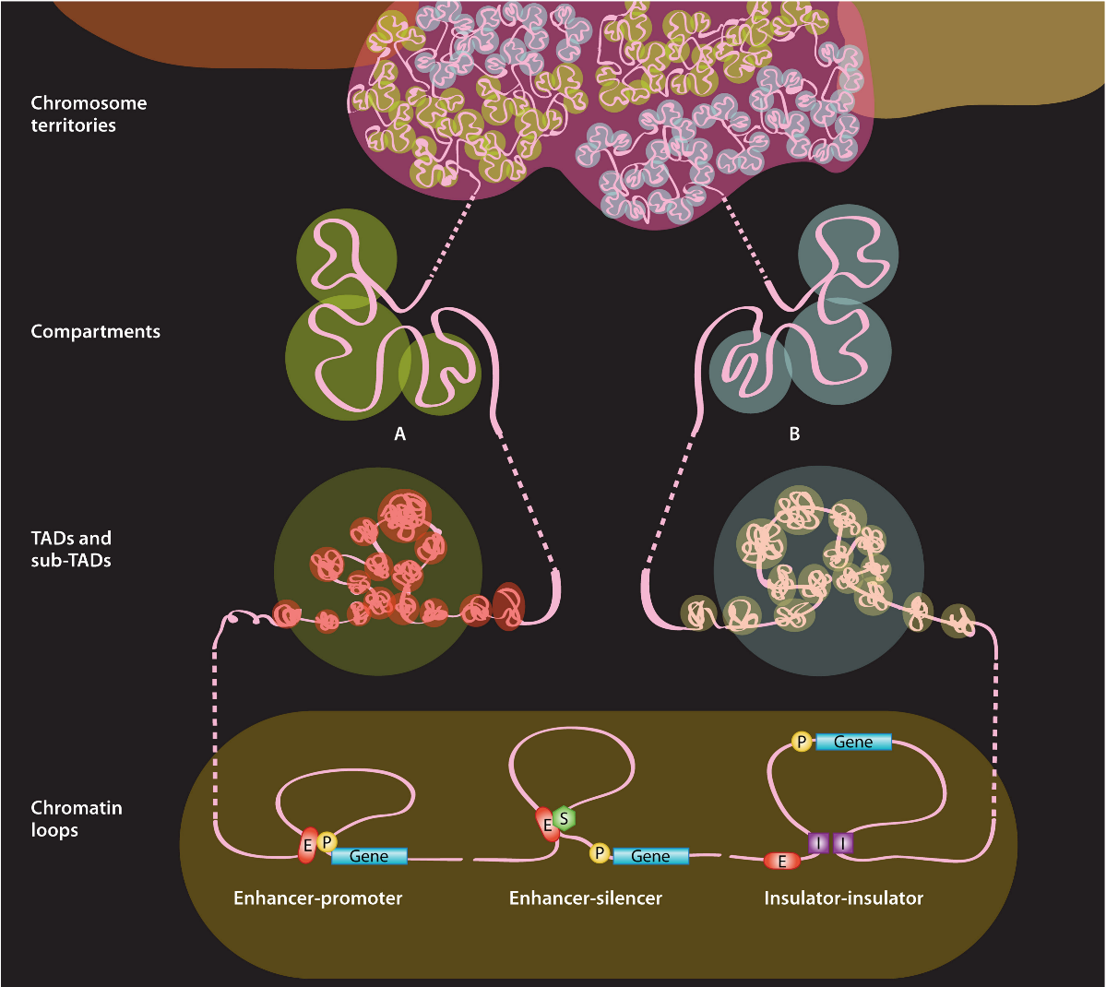
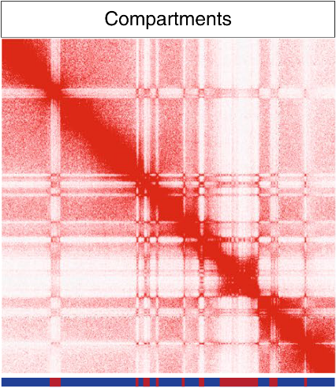
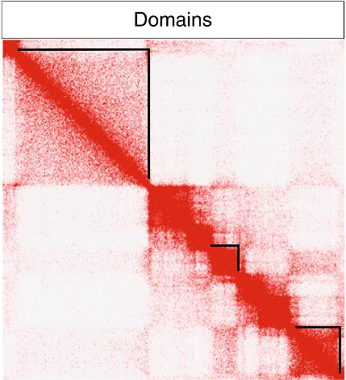
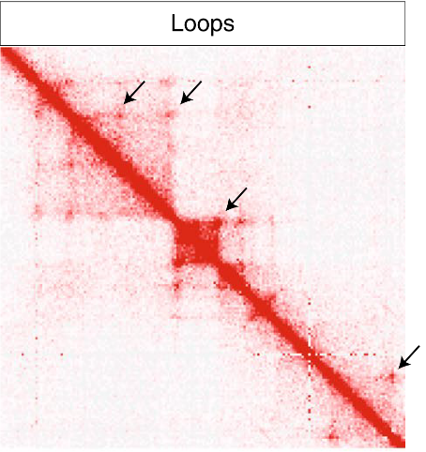
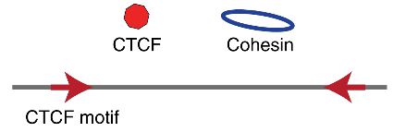
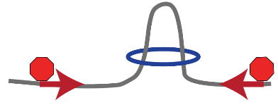
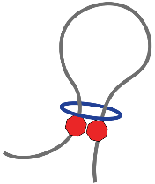
3D genome hierarchy
James Fraser, 2015. MMBR
Di Zhang, 2021. Nature Genetics

Slide 3
Compartment

Slide 4
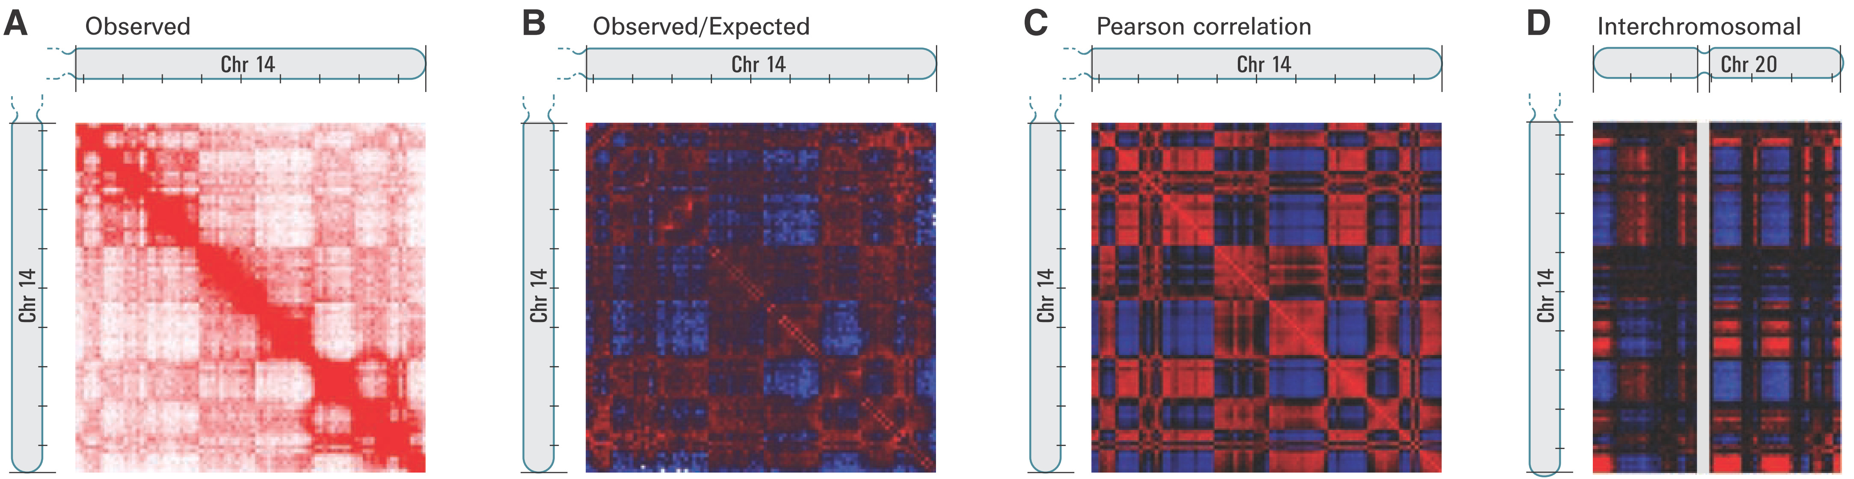

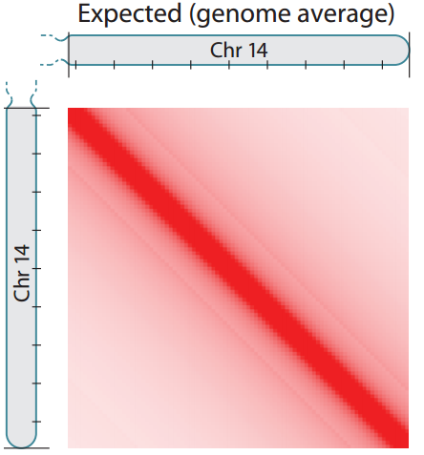
Erez Lieberman-Aiden, 2009. Science
PCA-based compartment analysis
We therefore defined a correlation matrix C in which c_{ij} is the Pearson correlation between the ith row and jth column of M*.

Slide 5
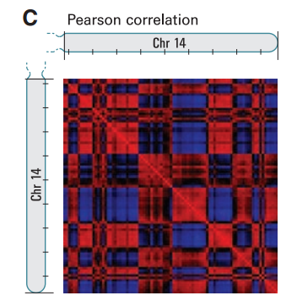

Erez Lieberman-Aiden, 2009. Science
PCA-based compartment analysis
PCA
Eigenvector：Correlation matrix进行PCA分析获得的第一特征向量，其正负间的变换决定了A/B compartment。
Cooltools通过OE矩阵进行PCA降维分析，获取到PC1值，以0为界分为两个compartments
但是算法无法确定哪个compartment是compartmentA(即更加活跃)，因此cooltools 提供了GC含量或基因密度信息输入接口，甚至也提供了H3K27ac等活跃marker的ChIP-seq信号来判定
hicexplorer hicPCA则提供了两种矩阵来做PCA降维分析，--pearsonMatrix指定采用pearson correlation矩阵，--obsexpMatrix指定采用O/E矩阵，同时也提供了基因密度和组蛋白修改信息接口

Slide 6
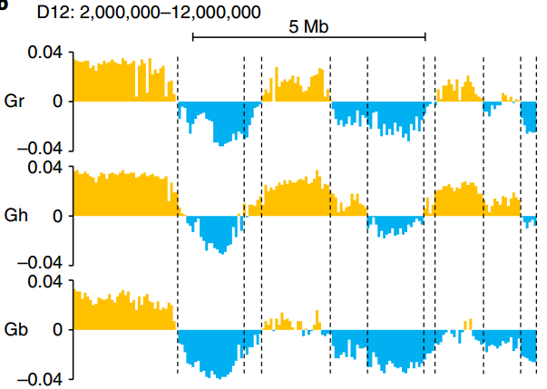
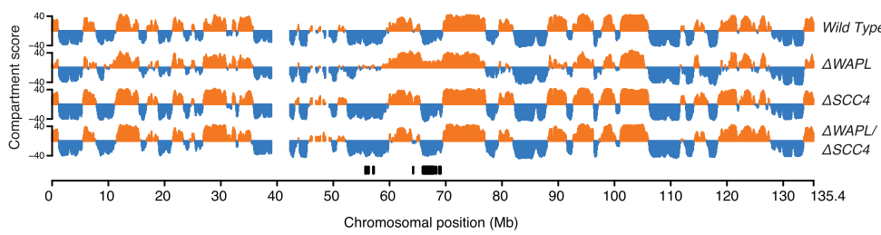
Judith H.I. Haarhuis, 2017. Cell
Maojun Wang, 2018. Nature Plants
Compartment switch
研究者发现不同的处理环境会影响compartment的A/B类型，另外，棉花多倍化进程中伴随着compartment switch
compartment A-to-B/B-to-A表明这段区域的活跃性改变
二倍体雷蒙德氏棉
G. raimondii
四倍体陆地棉
G. hirsutum
四倍体海岛棉
G. barbadense

Slide 7
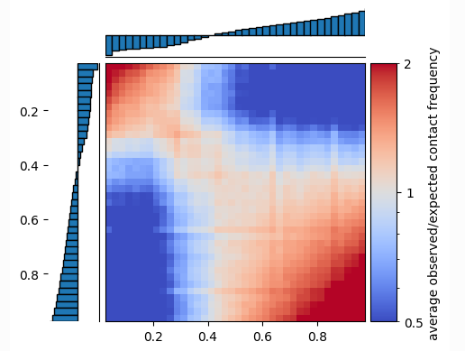
Compartment saddle plot
Compartment A/B类型变化相当于是质变，是否有方法度量量变？
相同类型的compartment的bins之间互作也在变化，例如两个bins都是A，即A-A互作的变化情况如何？
当然不能以每两个bins进行统计，这样会让变异抹平，无法有效比较，因此先按照compartment PC1值对bins进行划分，例如划分50等分，例如Eig(bin1)=0.75转化为degree=40 (0.72~0.76)
https://cooltools.readthedocs.io/en/latest/notebooks/compartments_and_saddles.html

Slide 8
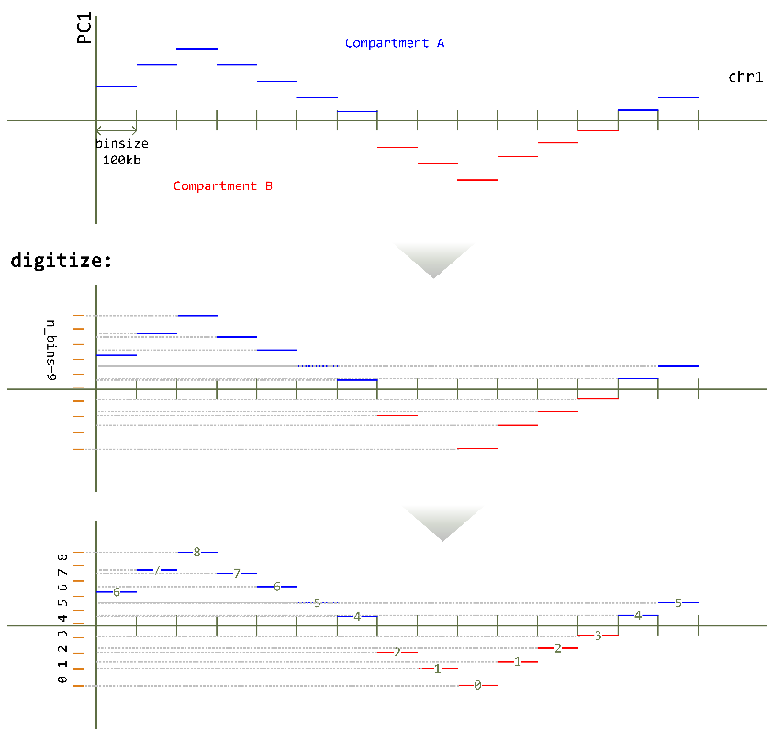
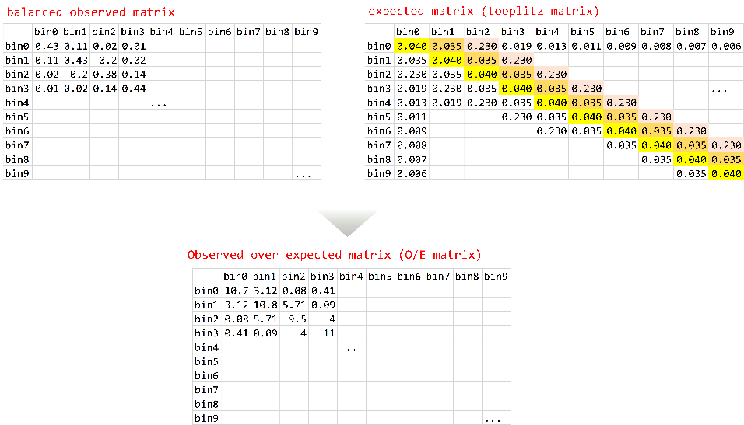
Compartment saddle plot
1. digitize
2. generate O/E matrix

Slide 9
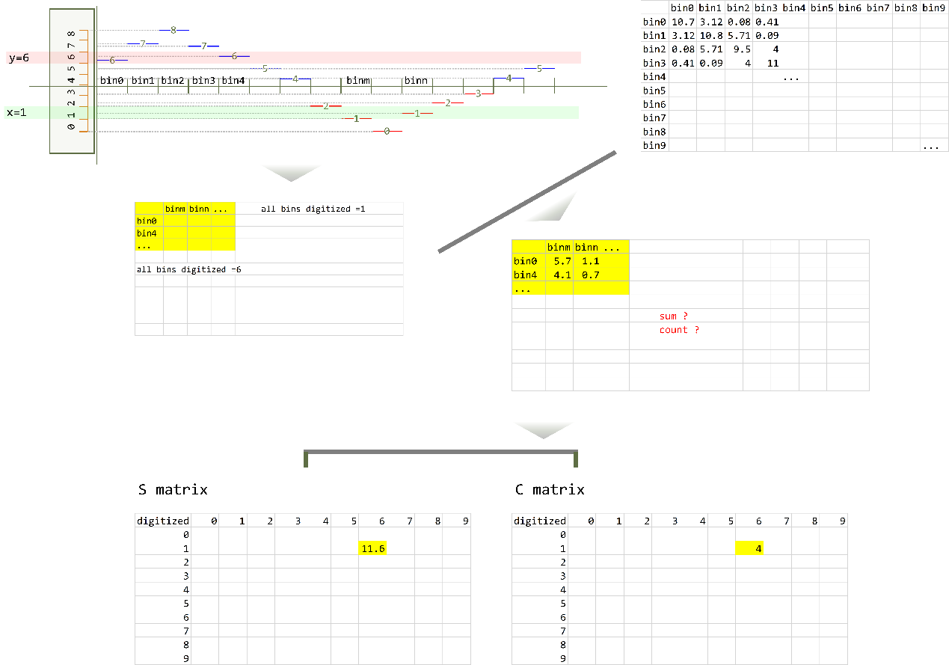
Compartment saddle plot
3. accumulate
获取compartment degree=1的bins和degree=6的bins
找到这些bins pairs在O/E矩阵中的值
拿到这些值后求合和计数，分别填入S(sum) matrix和C(count) matrix中(1, 6)的位置
再将S matrix每个单元格除以C matrix中对应单元格
最终得到的表格即为saddledata table

Slide 10
TAD

Slide 11
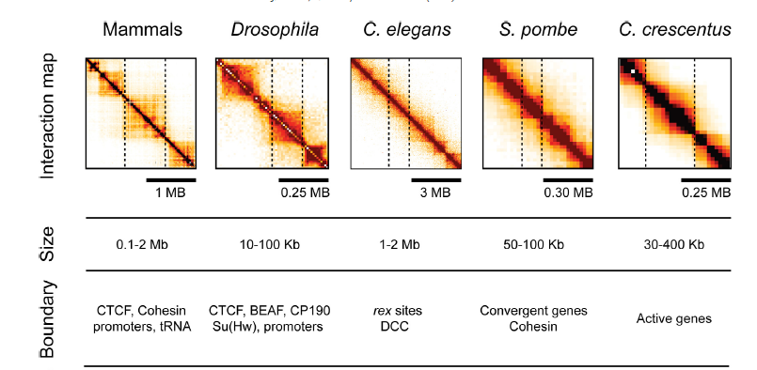
TAD size & boundaries
J. Dekker, 2015. FEBS Letters
Mariana Sotelo-Silveira, 2018. Trends in Plant Science
CTCF is absent from Arabidopsis and other plants, and clear TADs, 3D structural units separated by defined boundaries, were not so obvious in Arabidopsis as in other organisms.
'TAD-boundary like' region
However, Arabidopsis presented a local chromatin-packing feature, observed as positive strips, in the Hi-C map.
TCP motif in TAD-boundaries in rice
In rice, TAD boundary regions are positively associated with active gene expression, and, independently of gene expression levels, they are also enriched with a GC-rich motif that can be recognized by TCP proteins.

Slide 12
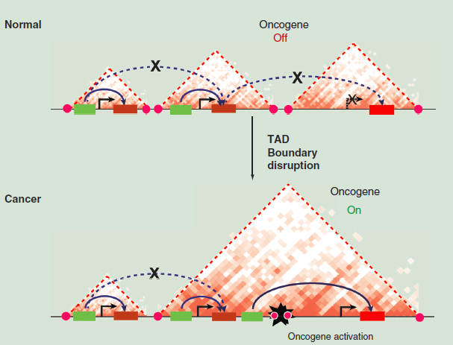
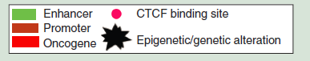
TAD size & boundaries
Joanna Achinger-Kawecka, 2017. Epigenomics
"enhancer hijack"

Slide 13
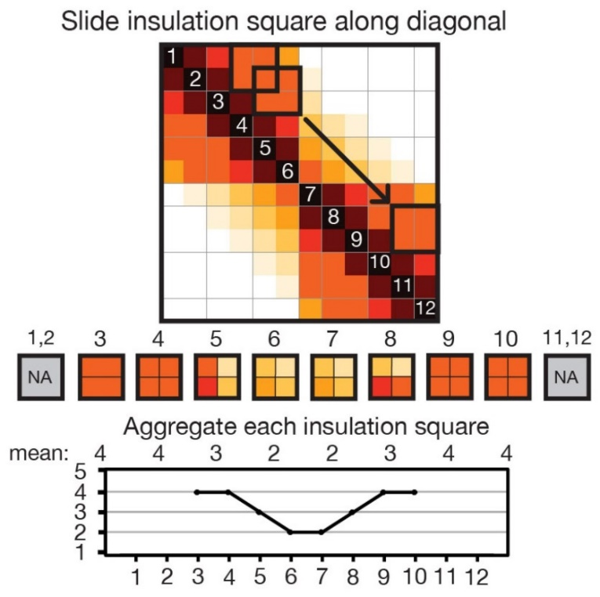
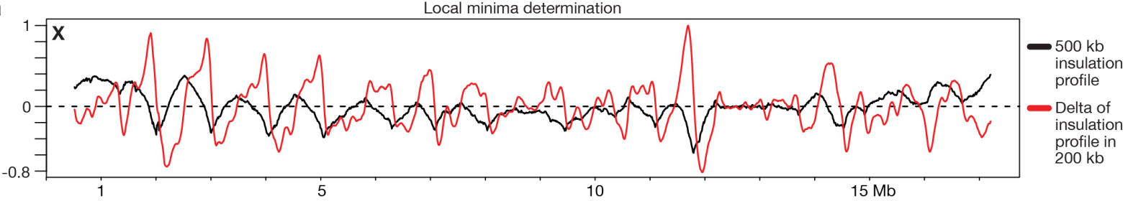

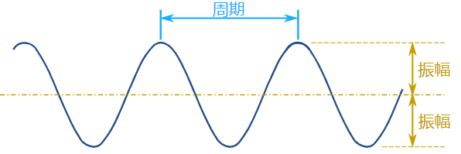
Principle and optimization of insulation score
Raw insulation score
1. 获取insulation score
以50个bins为一个square，沿diagonal bins滑动，获取insulation score vector
2. 过滤boundary bins (波谷位点)
既要考虑凹下去的区域长度(周期)，又要考虑到凹下去的程度(振幅)

Slide 14
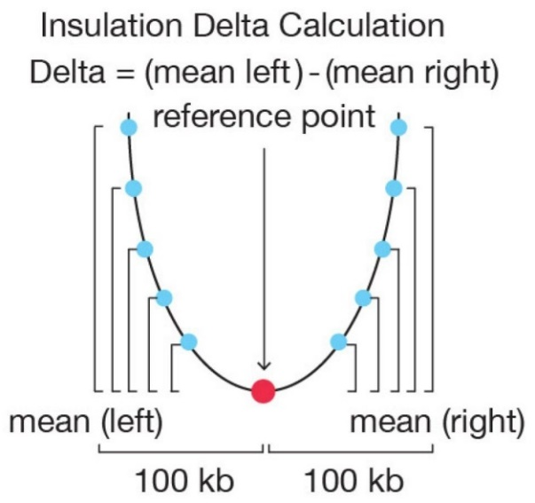
Principle and optimization of insulation score
Delta vector
The delta vector is defined as the difference between the amount of insulation change 100 kb to the left of the central bin and 100 kb to the right of the central bin (relative to the central bin)
delta score为0的bins，对应波峰或波谷，再去掉波峰，如下图中红色曲线
The boundary strength was defined as the difference in the delta vector between the local maximum to the left and local minimum to the right of the boundary bin.
boundary bin前后一定范围内，波的变化程度
All boundaries with a boundary strength<0.1 were removed.
去掉的是前后100kb变化不大的boundary bins，也即波形不够尖锐的。去掉的这些bins要么太平缓，要么波周期太短

Slide 15
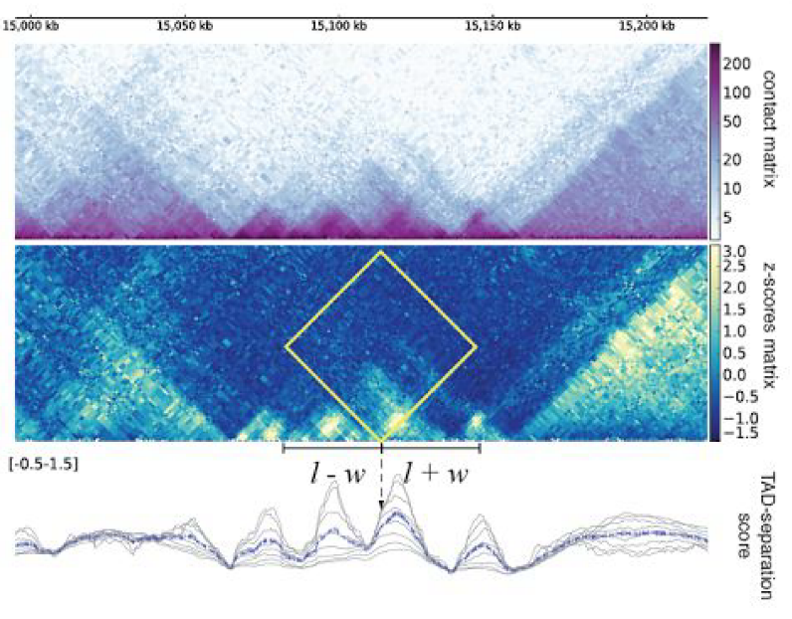
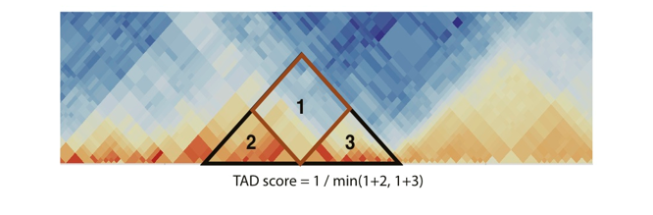
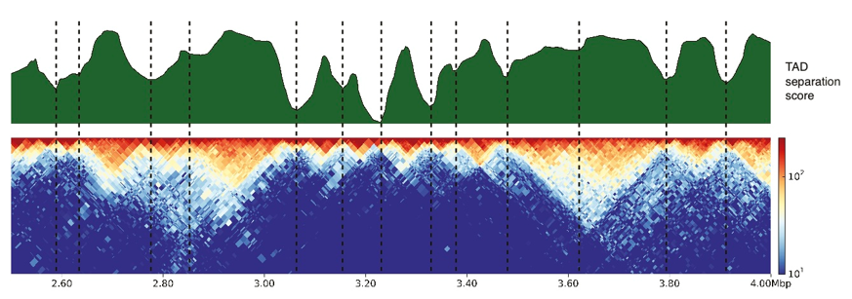
Principle and optimization of insulation score
hicexplorer hicFindTADs中insulation score的改进
z-score也是
基于互作矩阵
做变换，可以
类比于O/E矩阵
improved
The TAD-separation score at bin (​l​) corresponds to the mean values of the z-scores inside the ‘diamond’, which correspond to the contacts between a region of width ​w on left and on right.
High-Affinity Sites Form an Interaction Network to Facilitate Spreading of the MSL Complex across the X Chromosome in Drosophila. Fidel Ramírez et. al. Mol Cell. 2015
High-resolution TADs reveal DNA sequences underlying genome organization in flies. Fidel Ramírez et. al. Nat Commun. 2018

Slide 16
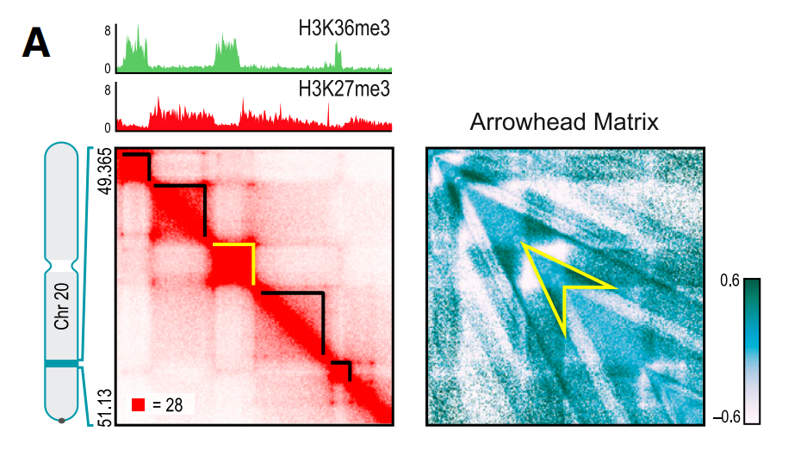
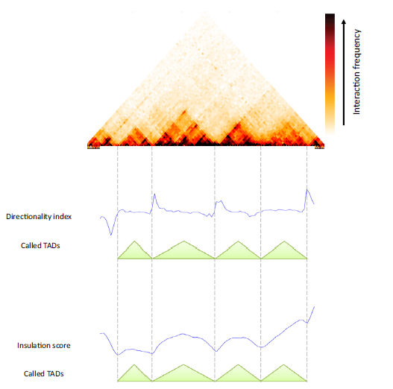
Suhas S.P. Rao, 2014．Cell
Anders S. Hansen, 2019. Molecular Cell
Bryan R. Lajoie, 2014. Methods
Principle and optimization of insulation score
Directionality index：顺着染色体滑动，TAD边界为其位点从倾向于与其上游互作转为与其下游互作。
Insulation score：TAD边界处的局部总互作相对较低。
A_{i,i+d} will be strong positive / negative if either one of i,i-d or i,i+d is inside the domain and one another is not, but A_{i,i+d} will be close to zero if both loci are inside or outside the domain.

Slide 17
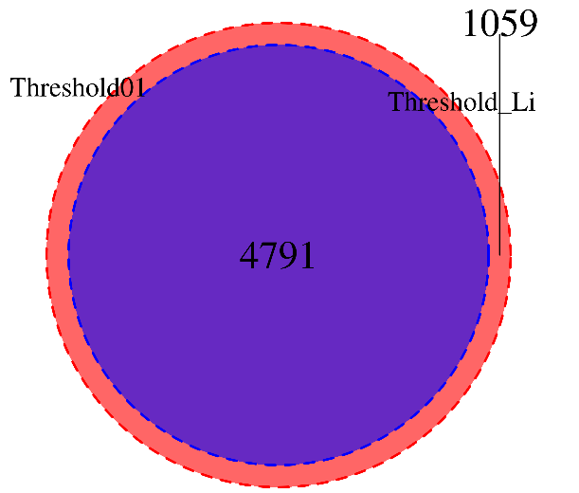
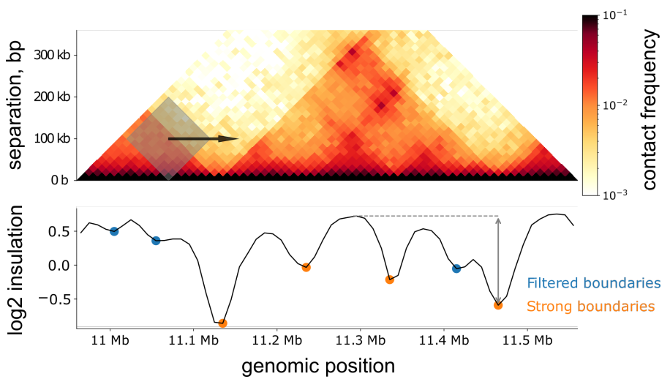
Open2C, Cooltools. bioRxiv
Principle and optimization of insulation score
cooltools diamond insulation
之前的测试结果：
Threshold0.1共检测到5850个boundaries，Threshold_Li检测到4791个boundaries
cooltools insulation通过指定--threshold对过滤掉weak boundaries。可选的有三种方法：
指定一个固定的小数，例如Wenliang Wang, 2022 Nature immunology和Hye Ji Cha, 2021. NC采用0.1作为阈值
指定为"Li"或"Otsu"，"Otsu is more conservative, whereas Li is more permissive."
这两种方法来自skimage.thresholding。
从结果来看指定为0.1时最多，Li时其次，Otsu时最少

Slide 18
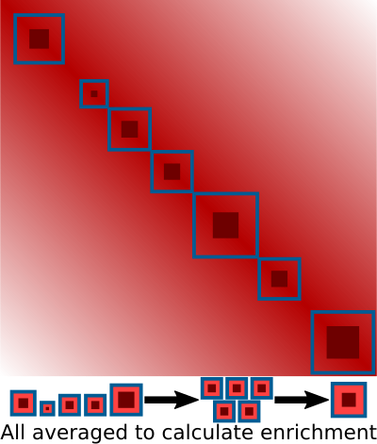
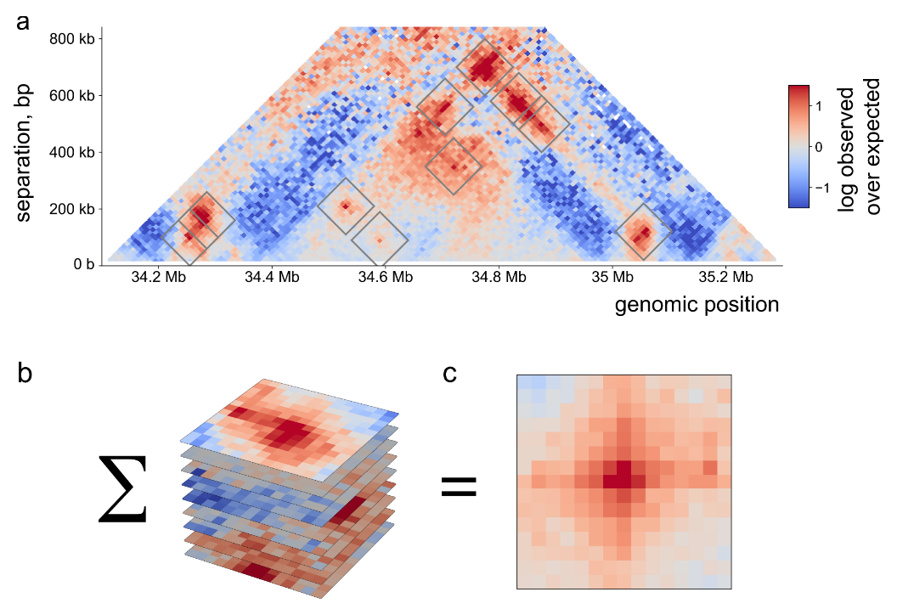

Aggregate TAD analysis | domain ATA
Pileups or aggregate analysis
The principle of domain ATA
TAD

Slide 19
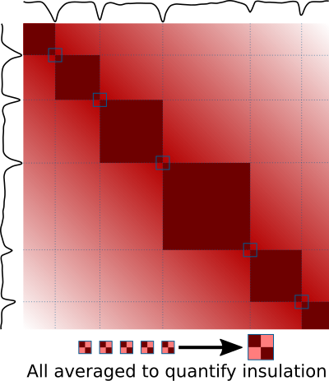
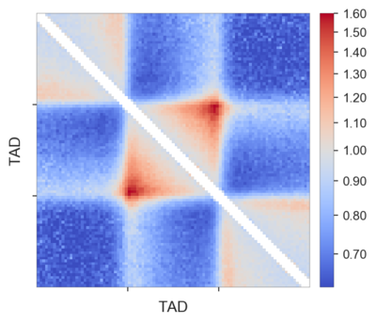
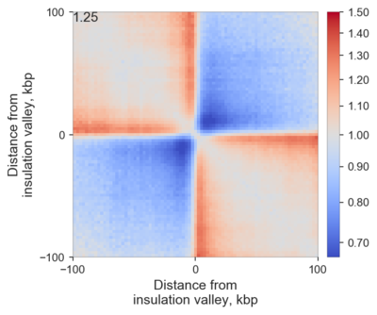
ATA | boundary ATA
The principle of boundary ATA
output of domain ATA
output of boundary ATA

Slide 20
Loops

Slide 21
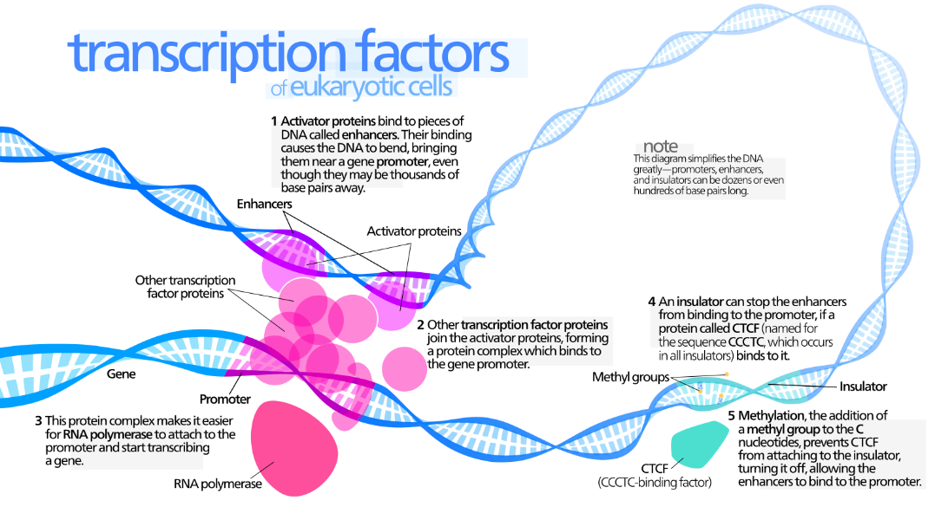
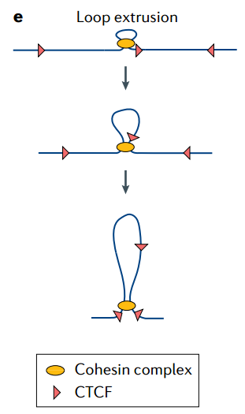
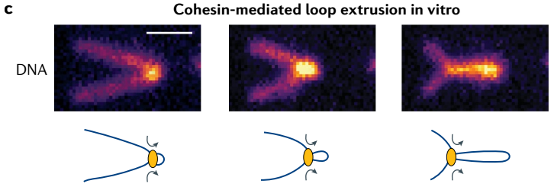
Loops

Slide 22
Abbas Roayaei Ardakany, 2020. Genome Biology
Loops & significant interactions
显著互作
通过统计学计算得到。互作图谱上两点间的互作强度显著超过随机水平的点为显著互作。
Loops
染色质的环状结构。
区别
显著互作是数学分析结果，loops是生物学染色质分子结构。我们通过显著互作结果推断loops结构。
These existing loops calling methods broadly fall into two groups:
global enrichment-based methods, eg. Fit-Hi-C (i) globally fit statistical/probabilistic models to the contact map data
(ii) assign p values to each individual pixel/entry in the contact map by comparing the observed count values
to the expected values computed from the fitted model.
local enrichment-based (loop calling) methods, eg. HiCCUPs & Mustache identifies 2D peaks in contact map that are not only significantly higher than expected from the global background, but also are local maxima with respect to their neighboring pixels.

Slide 23
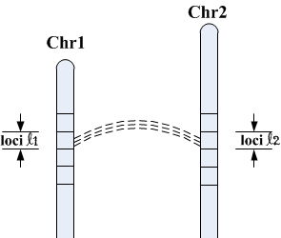
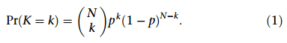
Ferhat Ay, 2014. Genome Research
FitHiC2
主流loop calling工具中，唯一可以检测trans显著互作的工具
我们先对chr1和chr2划分loucs
再从chr1上拿一个loci，从chr2拿一个loci进行组合，数一下loci1-loci1, loci1-loci2, ... lociℓ1-lociℓ2...，总的可能的组合情况是有M种，每一种组合被取到的概率为1/M。
一对reads肯定是这M种组合中的一种，假设有3对PE reads，随机地往上述M种组合中放，如左图lociℓ1-lociℓ2这种组合有k对read-pair的概率，符合二项分布
抛5次正常的硬币，求正好有3次正面朝上的概率，符合二项分布
p => 1/M，N是假设的3对read-pairs，k是这3个PE reads恰好
有k对是lociℓ1-lociℓ2组合

Slide 24
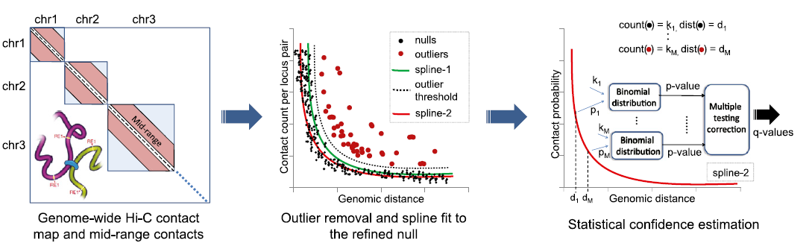
Ferhat Ay, 2014. Genome Research
FitHiC2
上页是染色体间互作的情况，如果是染色体内两个locus互作的情况，还需要考虑互作随距离衰减，不能直接采用二项分布检验计算。Ferhat Ay等人提出了一套距离矫正方法：
(1) 根据所有互作的概率与距离绘图，例如0-100kb，100kb-200kb，200kb-300k...等分档来算，每个档位的互作概率大致相同，拟合互作概率-距离曲线(spline-1)；
(2) 设定阈值排除异常点(outliers)，并重新拟合互作概率-距离曲线(spline-2)，也可进行多次迭代，通常迭代两次即可
(3) 跟据spline-N设定不同互作距离下的互作概率p，使用二项分布检验计算p-value，并进行多重检验计算q-value。

Slide 25
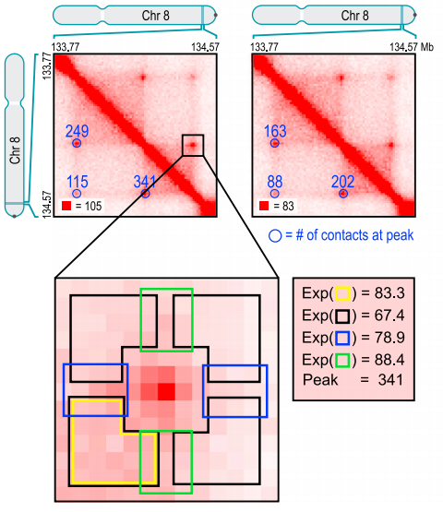
HiCCUPS
(1) 将互作图谱局部区域分为中心区；上下区；左右区；四周区；左下区。
(2) 中心区要显著高于其他区域；
(3) 左下区要高于四周区
注：该计算及其消耗CPU，juicertools中采用GPU代替CPU运算。
loops长度最大2mb

Slide 26
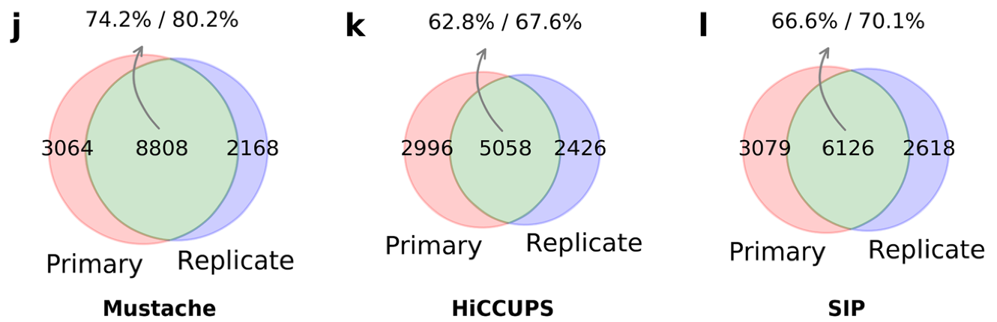
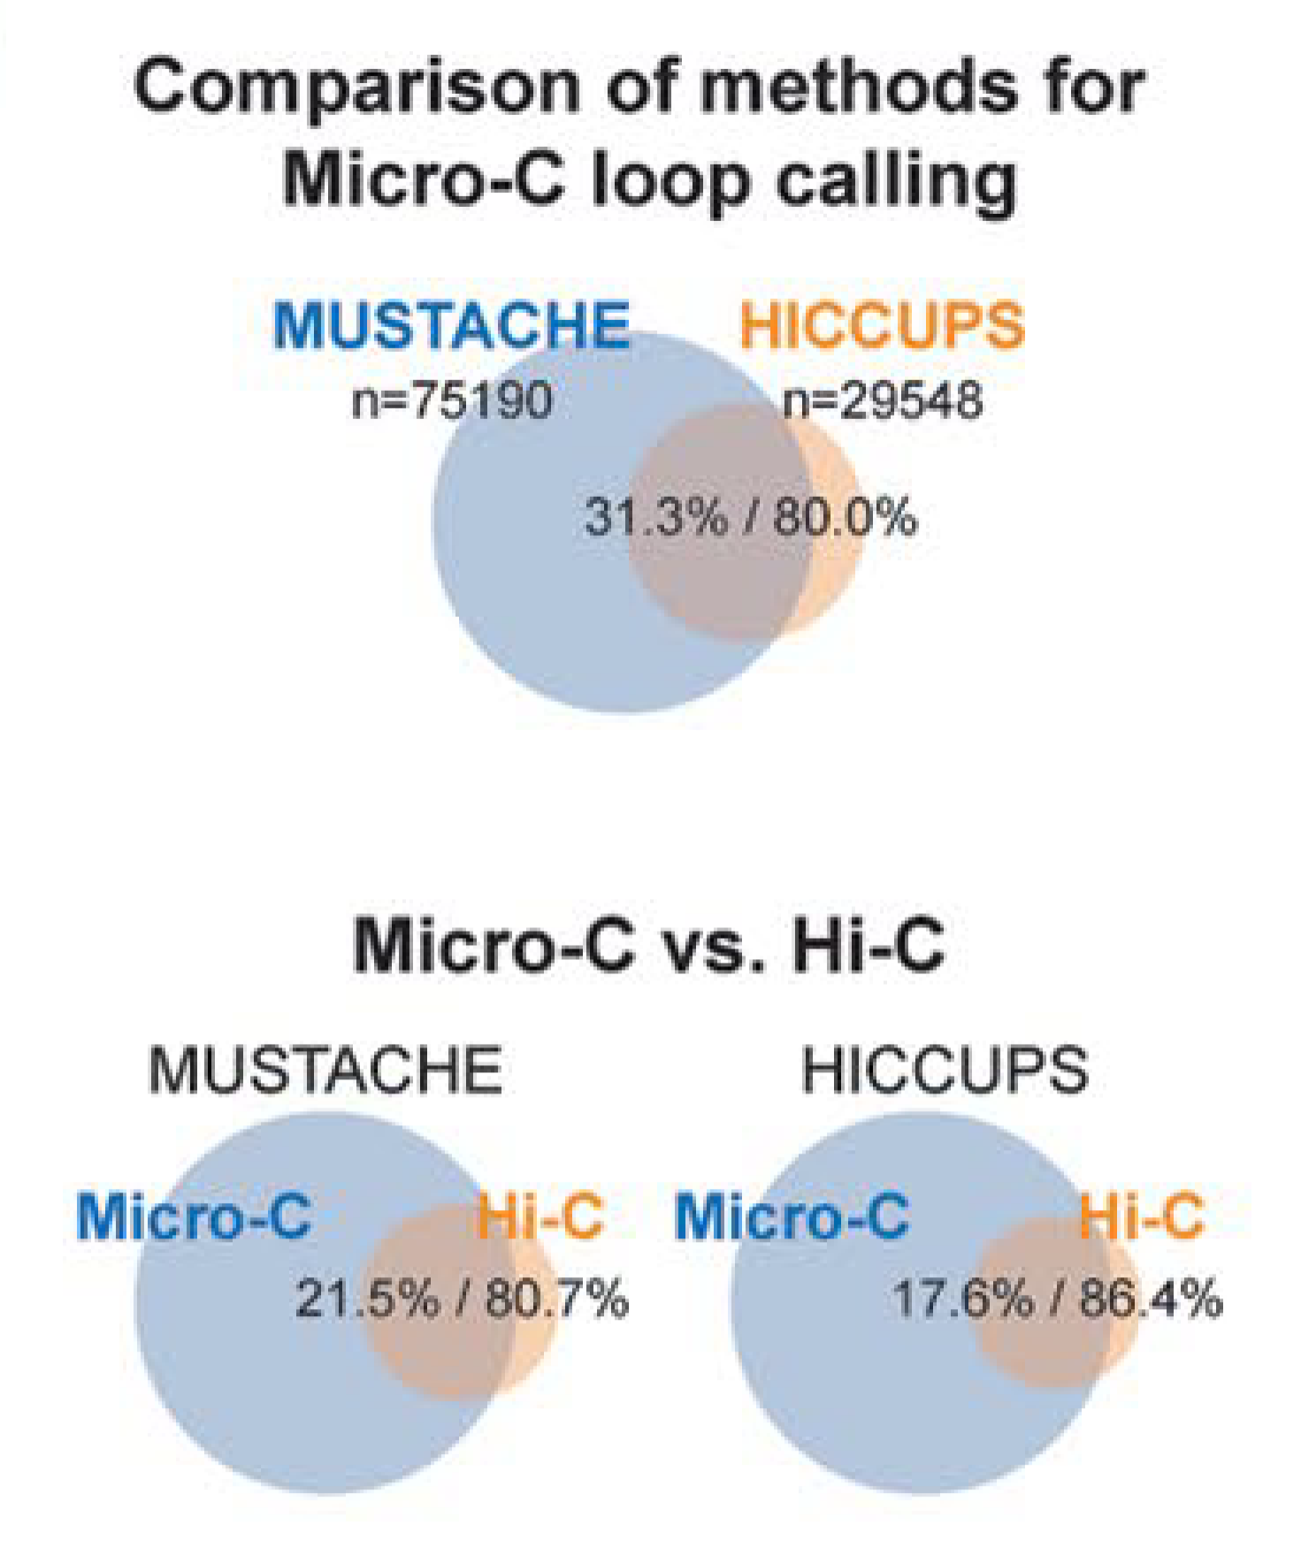
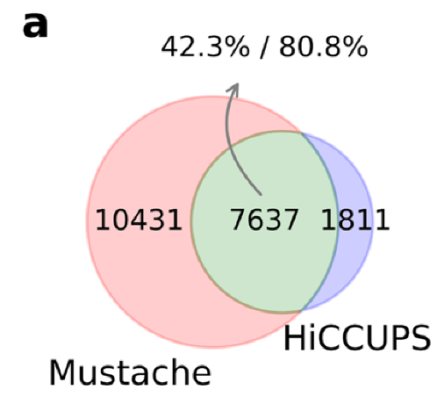
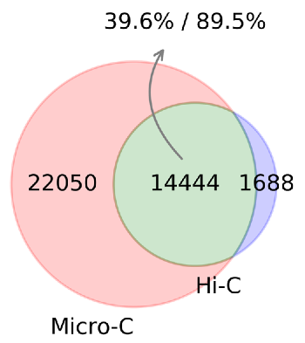
Mustache vs HiCCUPS
Abbas Roayaei Ardakany, 2020. Genome Biology Tsung-Han S. Hsieh, 2020. nature genetics
生物学重复样本单独call loops，再做overlap，Mustache结果比HiCCUPS好
Mastache检出的loops更多，而且在micro-C数据loops检测结果更好

Slide 27
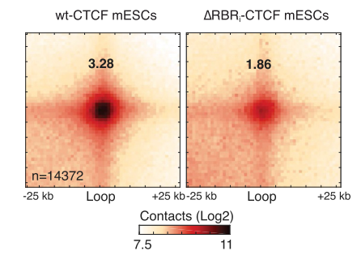

APA分析
先获取某些有特定意义的loops，比方说处理组相对于对照组增加的loops
再在两个样本的互作矩阵上同时找这些loops (loops相同，矩阵不同)
通过APA计算这些loops的强度变化

Slide 28
Stripe

Slide 29
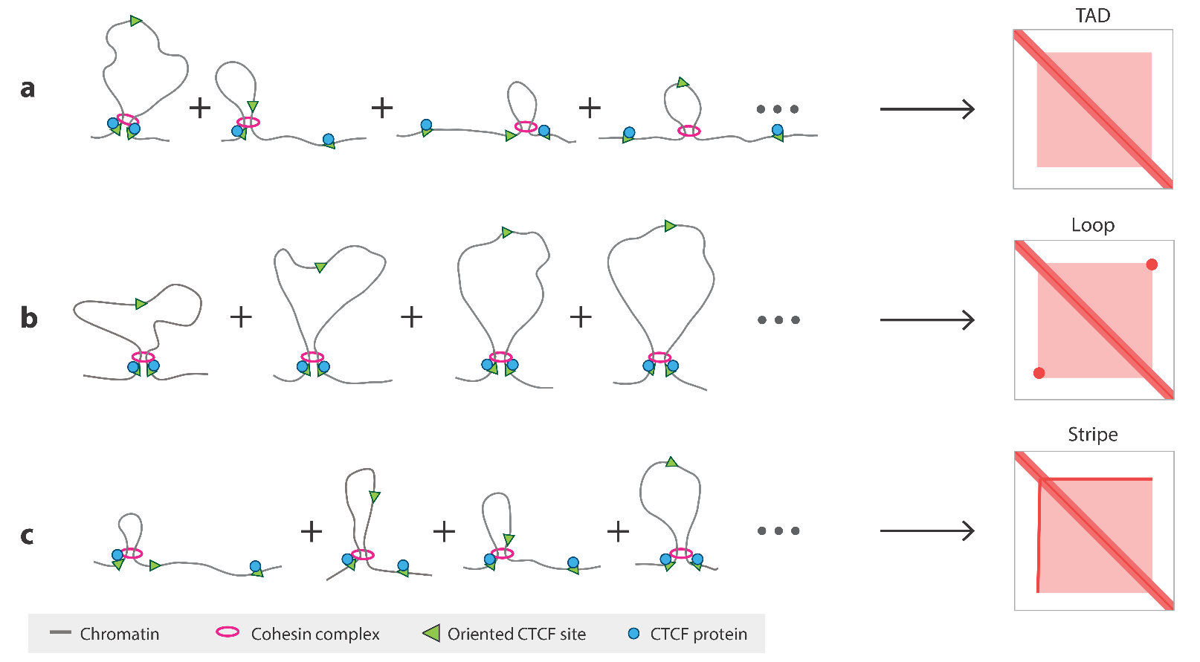
Stripe
Jyotsana J. Parmar, 2019. Annu. Rev. Biophys
cohesion complex可以在TAD内自由移动
loop 两个anchor
不能移动
strip是一边固定，
一边可以自由移动

Slide 30
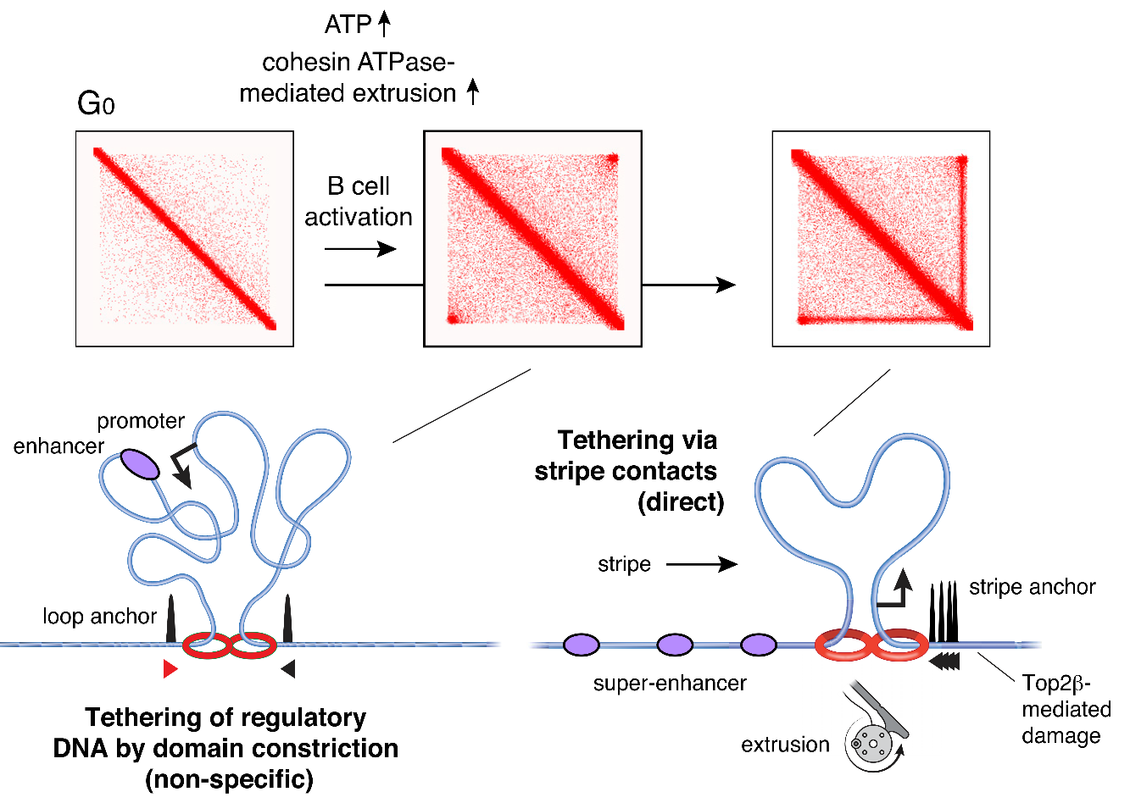
Stripe
Laura Vian, 2018. Cell
super-enhancer
调控基因表达

Slide 31
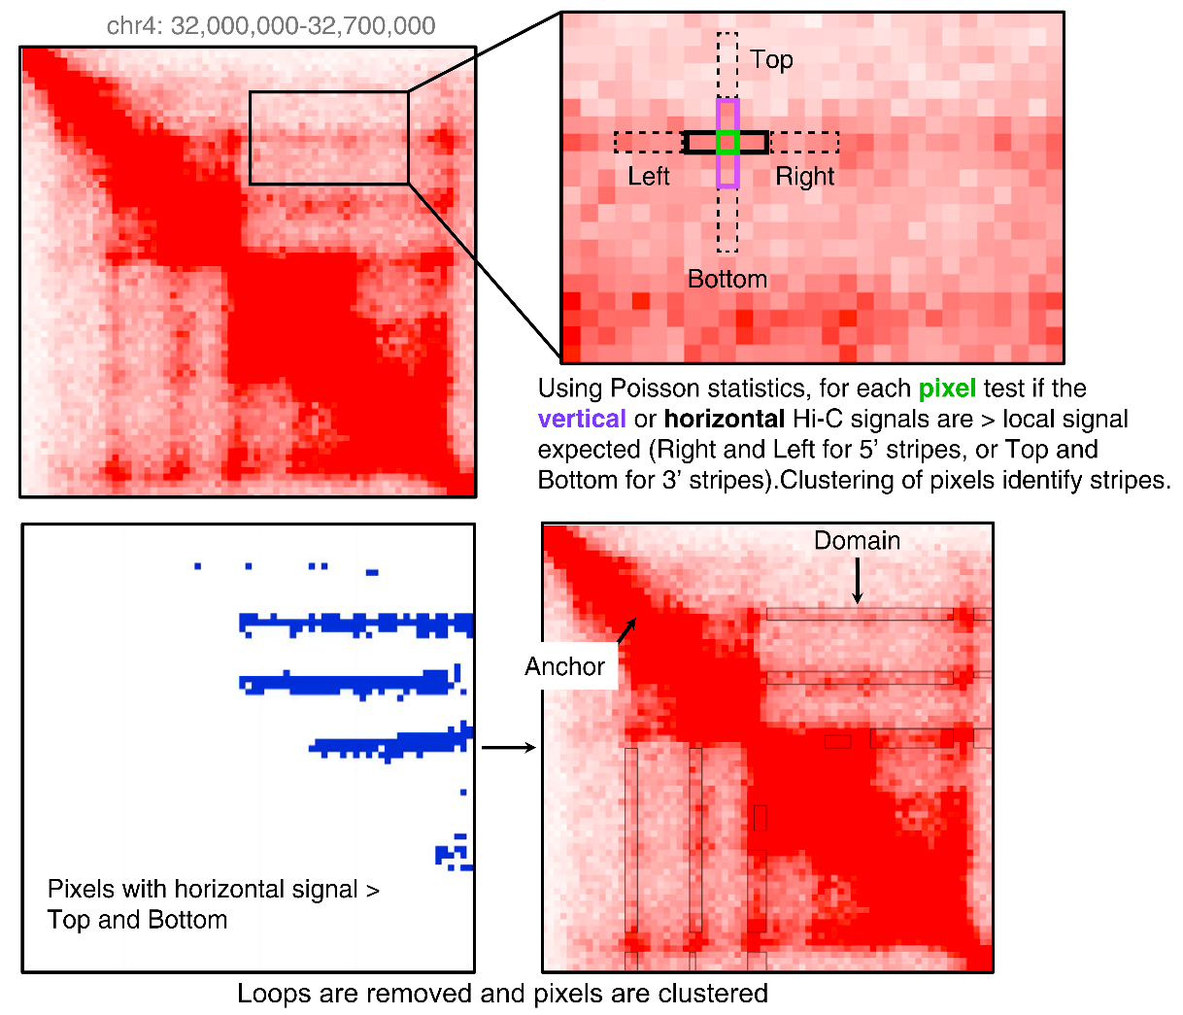
Stripe
Laura Vian, 2018. Cell
Jie Xu, 2022. Nature
以检测横向的strip (5 prime stripes)为例，先看看bin_{ij}的Top和Bottom区域，即粉色框里的互作是否强于黑色框里的，如果黑色框更强则为可能的5' stripes。再对这些可能的bins进行聚类(如右下图)聚类完获取最终的5' stripes domain
纵向的也是一样，当然只需要检测右上三角形即可。因为Hi-C matrix是沿对角线对称的
根据stripe的生物学意义，在stripecaller中还可以输出loops和TAD信息，它会检测和TAD boundary有互作，而且loops比较密集的stripe，这样的结果更加可信

